Slide 1
Your Name

Slide 2

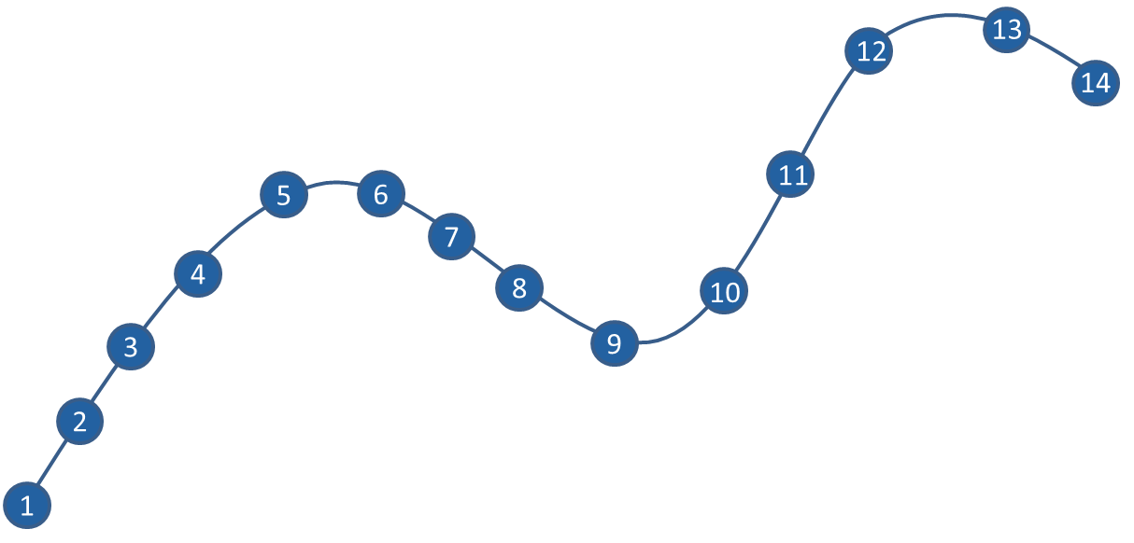
Where this fits

Slide 3
Goal
For you to have a good understanding of:
what is …
when it is appropriate to use…
the steps to implement ….
The goal is not to …

Slide 4
What You’ll Learn Today:
Part 1 Title
Part 2 Title
Part 3 Title
Add as many as needed

Slide 5
1. Part 1 Title

Slide 7
2. Part 2 Title

